Slide 1
Computer vision: models, learning and inference
Chapter 8
Regression

Slide 2
Structure
Linear regression
Bayesian solution
Non-linear regression
Kernelization and Gaussian processes
Sparse linear regression
Dual linear regression
Relevance vector regression
Applications
Computer vision: models, learning and inference. ©2011 Simon J.D. Prince
2

Slide 3
Models for machine vision
Computer vision: models, learning and inference. ©2011 Simon J.D. Prince
3

Slide 4
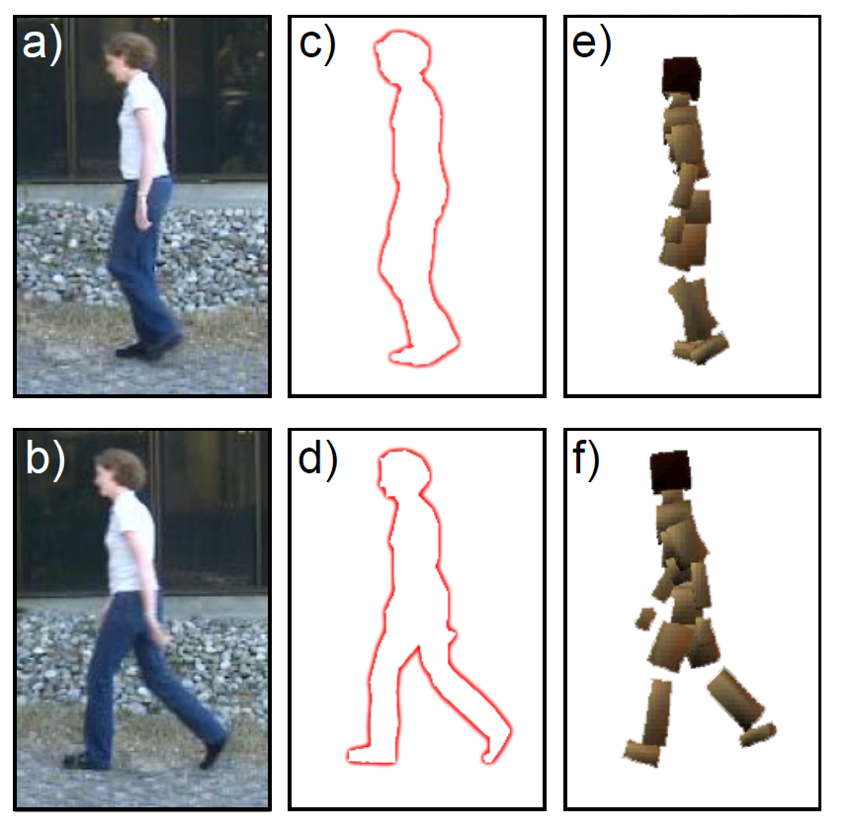
Body Pose Regression
Encode silhouette as 100x1 vector, encode body pose as 55 x1 vector. Learn relationship
Computer vision: models, learning and inference. ©2011 Simon J.D. Prince
4

Slide 5
Type 1: Model Pr(w|x) - Discriminative
How to model Pr(w|x)?
Choose an appropriate form for Pr(w)
Make parameters a function of x
Function takes parameters θ that define its shape
Learning algorithm: learn parameters θ from training data x,w
Inference algorithm: just evaluate Pr(w|x)
Computer vision: models, learning and inference. ©2011 Simon J.D. Prince
5

Slide 6
Linear Regression
For simplicity we will assume that each dimension of world is predicted separately.
Concentrate on predicting a univariate world state w.
Choose normal distribution over world w
Make
Mean a linear function of data x
Variance constant
Computer vision: models, learning and inference. ©2011 Simon J.D. Prince
6

Slide 7
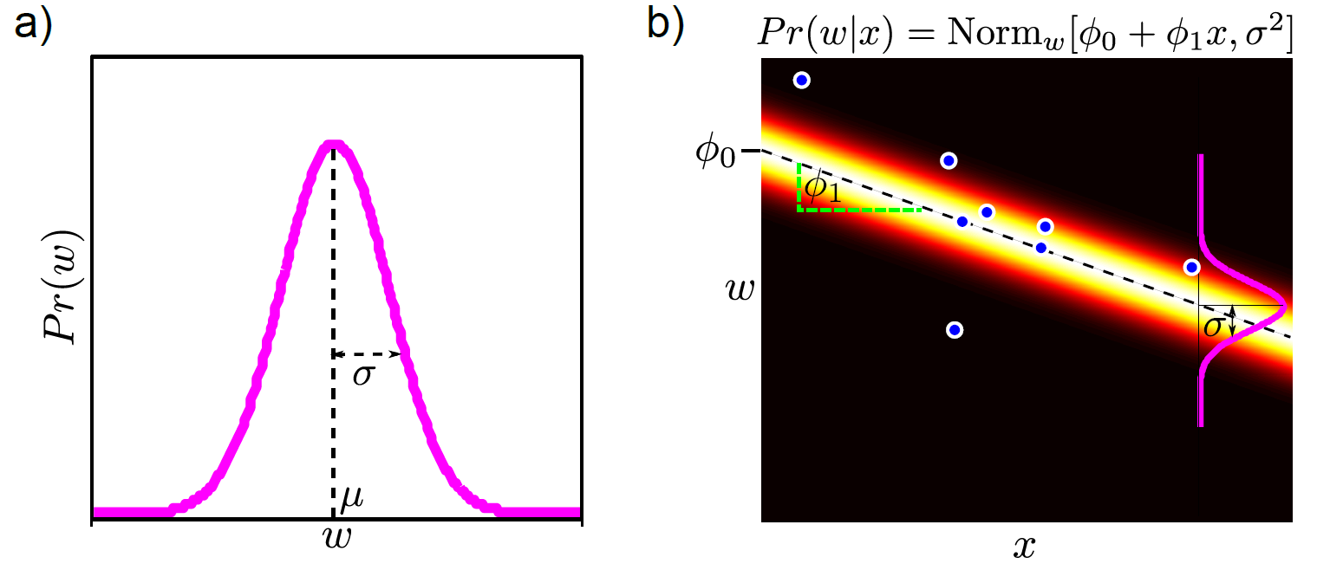
Linear Regression
Computer vision: models, learning and inference. ©2011 Simon J.D. Prince
7

Slide 8
Neater Notation
To make notation easier to handle, we
Attach a 1 to the start of every data vector
Attach the offset to the start of the gradient vector φ
New model:
Computer vision: models, learning and inference. ©2011 Simon J.D. Prince
8

Slide 9
Combining Equations
We have one equation for each x,w pair:
The likelihood of the whole dataset is the product of these individual distributions and can be written as
where
Computer vision: models, learning and inference. ©2011 Simon J.D. Prince
9

Slide 10
Learning
Maximum likelihood
Substituting in
Take derivative, set result to zero and re-arrange:
Computer vision: models, learning and inference. ©2011 Simon J.D. Prince
10

Slide 11
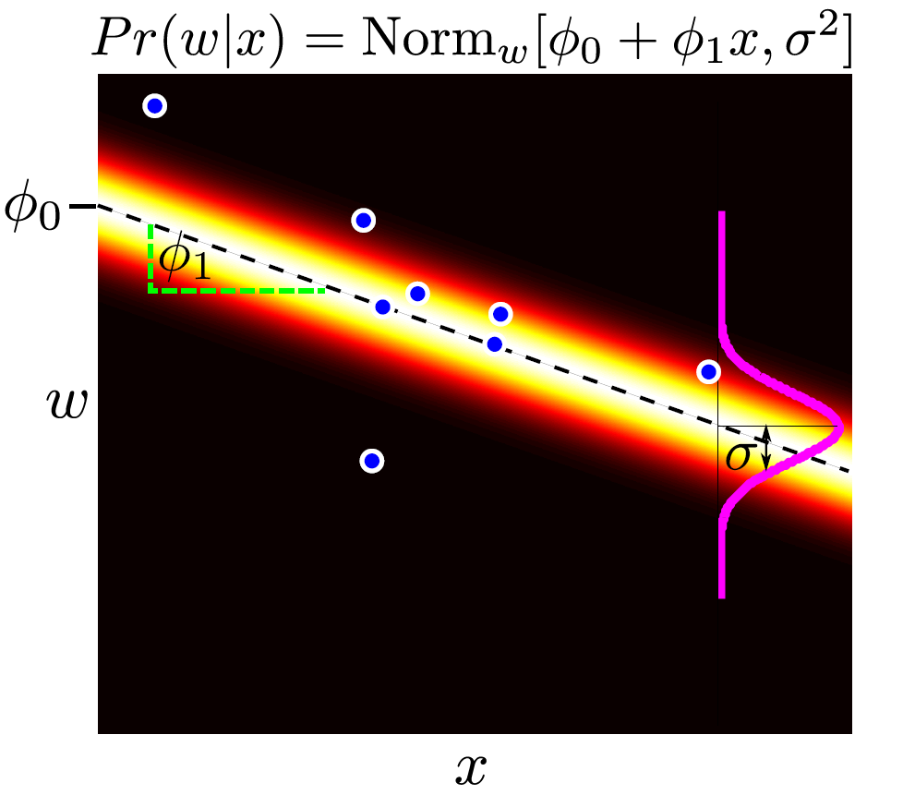
Computer vision: models, learning and inference. ©2011 Simon J.D. Prince
11

Slide 12
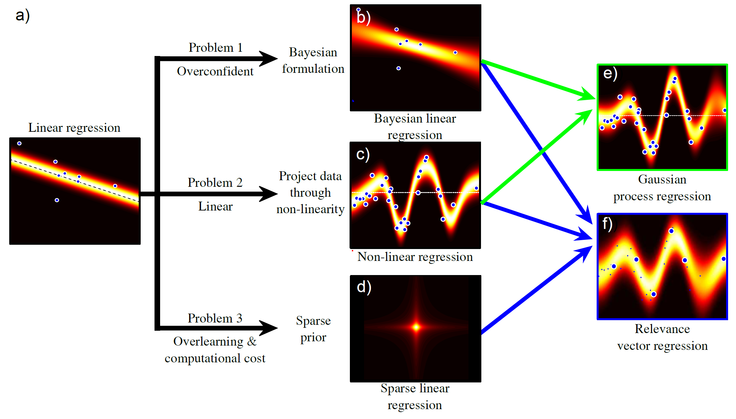
Regression Models
Computer vision: models, learning and inference. ©2011 Simon J.D. Prince
12

Slide 13
Structure
Linear regression
Bayesian solution
Non-linear regression
Kernelization and Gaussian processes
Sparse linear regression
Dual linear regression
Relevance vector regression
Applications
Computer vision: models, learning and inference. ©2011 Simon J.D. Prince
13

Slide 14
Bayesian Regression
(We concentrate on φ – come back to σ² later!)
Likelihood
Prior
Bayes rule’
Computer vision: models, learning and inference. ©2011 Simon J.D. Prince
14

Slide 15
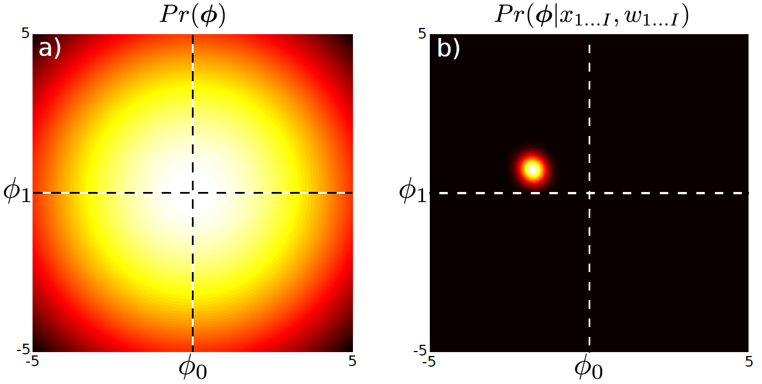
Posterior Dist. over Parameters
where
Computer vision: models, learning and inference. ©2011 Simon J.D. Prince
15

Slide 16
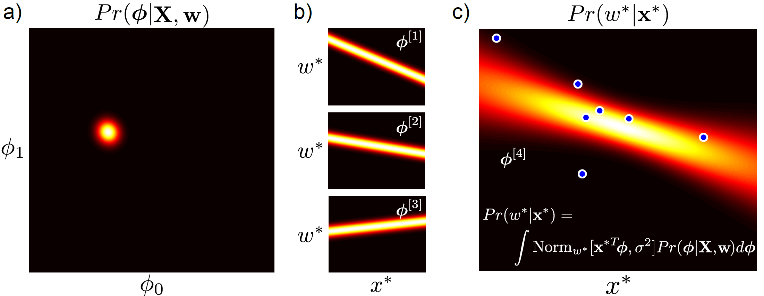
Inference
Computer vision: models, learning and inference. ©2011 Simon J.D. Prince
16

Slide 17
Practical Issue
Problem: In high dimensions, the matrix A may be too big to invert
Solution: Re-express using Matrix Inversion Lemma
Final expression: inverses are (I x I) , not (D x D)
Computer vision: models, learning and inference. ©2011 Simon J.D. Prince
17

Slide 18
Fitting Variance
We’ll fit the variance with maximum likelihood
Optimize the marginal likelihood (likelihood after gradients have been integrated out)
Computer vision: models, learning and inference. ©2011 Simon J.D. Prince
18

Slide 19
Structure
Linear regression
Bayesian solution
Non-linear regression
Kernelization and Gaussian processes
Sparse linear regression
Dual linear regression
Relevance vector regression
Applications
Computer vision: models, learning and inference. ©2011 Simon J.D. Prince
19

Slide 20
Regression Models
Computer vision: models, learning and inference. ©2011 Simon J.D. Prince
20

Slide 21
Non-Linear Regression
GOAL:
Keep the math of linear regression, but extend to more general functions
KEY IDEA:
You can make a non-linear function from a linear weighted sum of non-linear basis functions
Computer vision: models, learning and inference. ©2011 Simon J.D. Prince
21

Slide 22
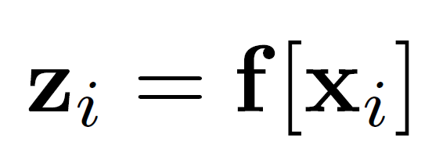
Non-linear regression
Linear regression:
Non-Linear regression:
where
In other words, create z by evaluating x against basis functions, then linearly regress against z.
Computer vision: models, learning and inference. ©2011 Simon J.D. Prince
22

Slide 23
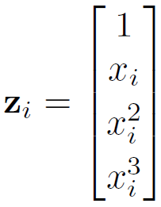
Example: polynomial regression
A special case of
Where
Computer vision: models, learning and inference. ©2011 Simon J.D. Prince
23

Slide 24
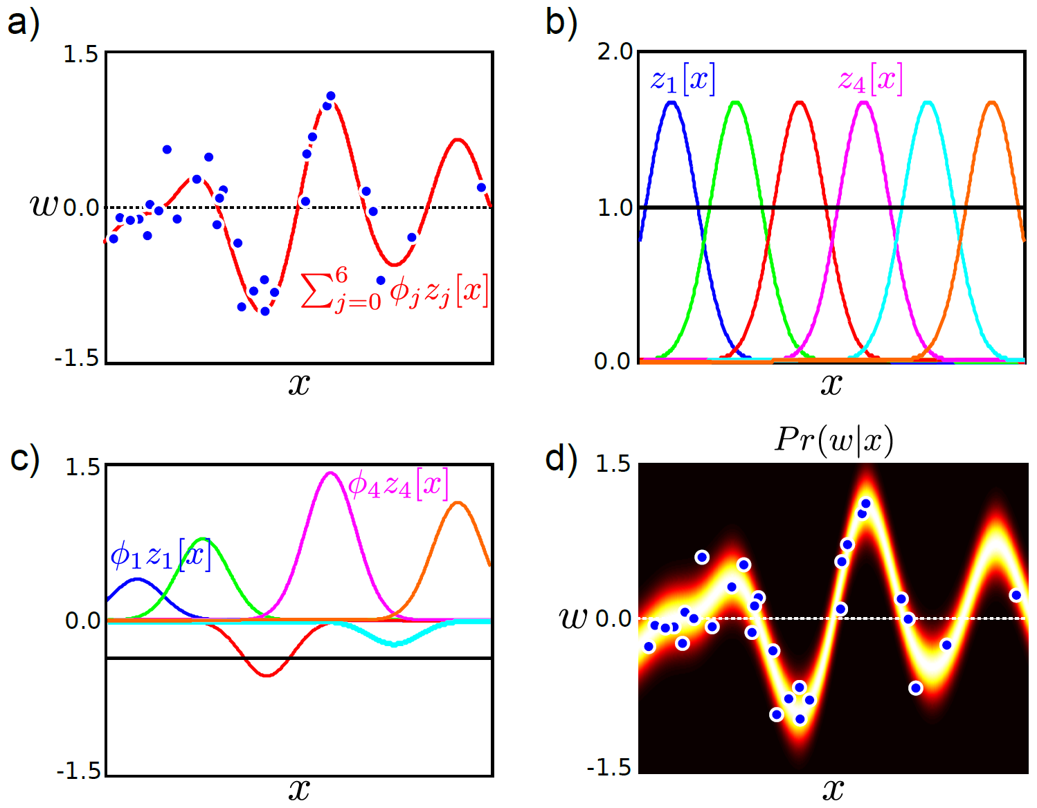
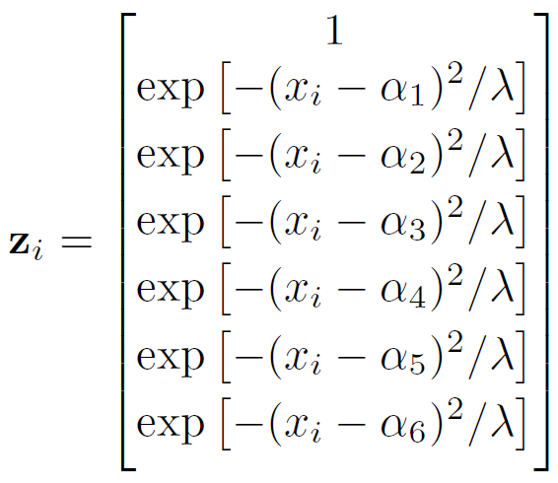
Radial basis functions
Computer vision: models, learning and inference. ©2011 Simon J.D. Prince
24

Slide 25
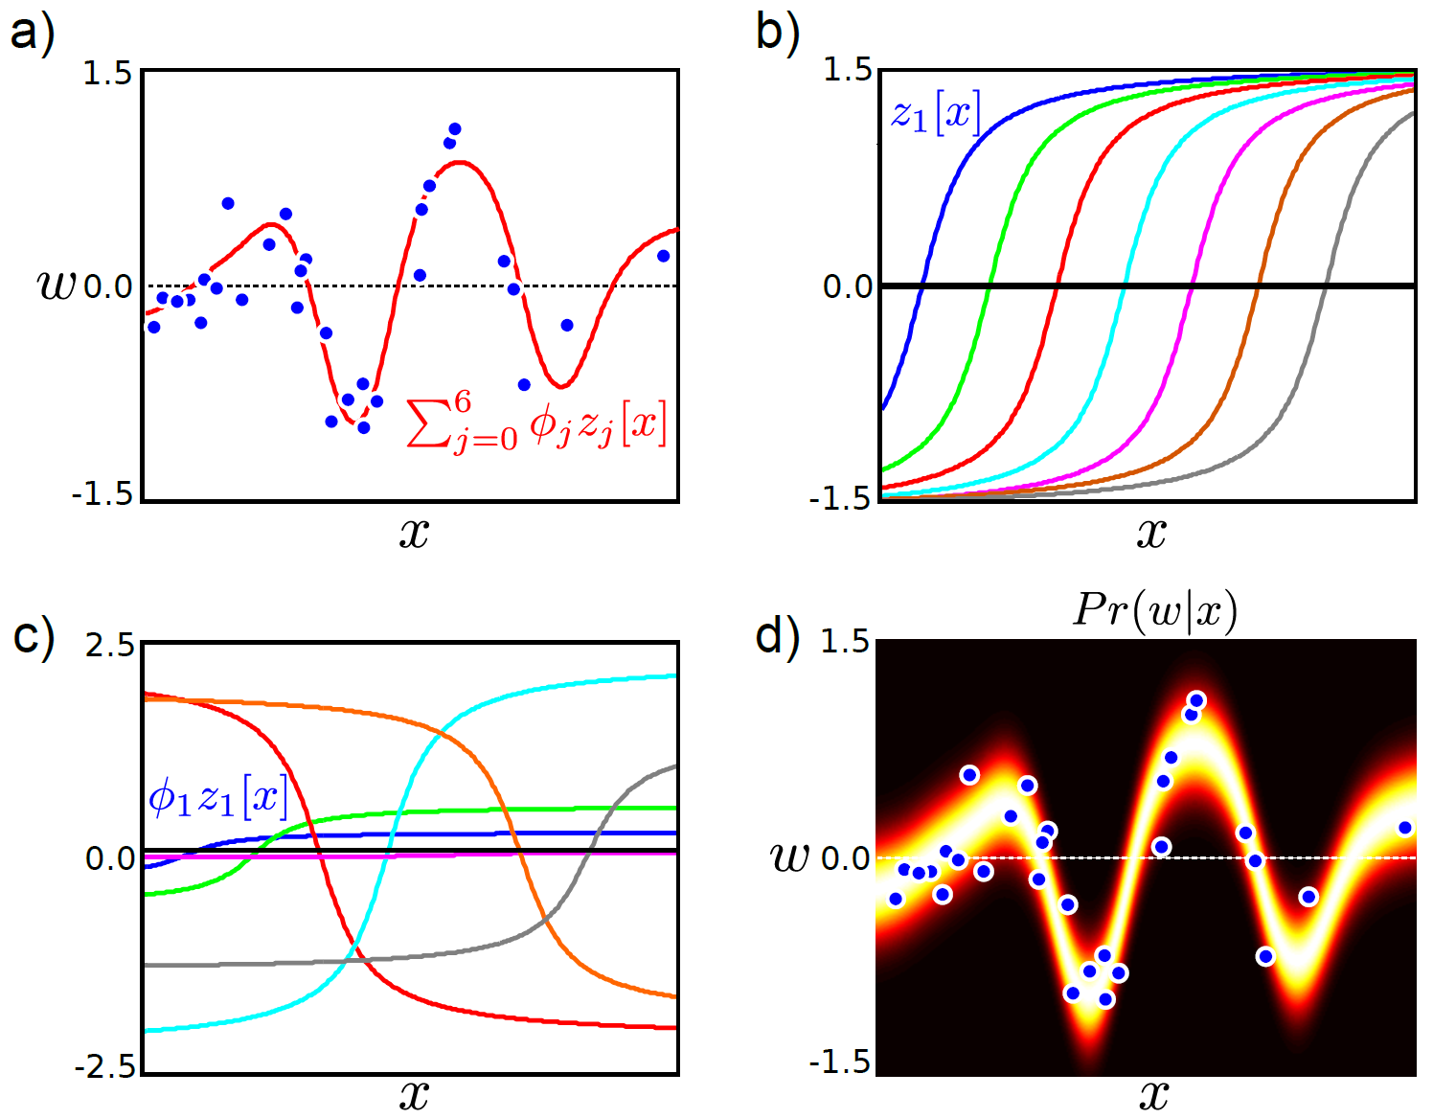
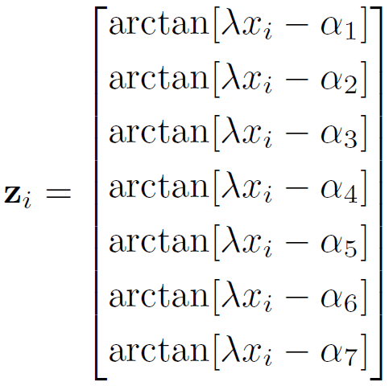
Arc Tan Functions
Computer vision: models, learning and inference. ©2011 Simon J.D. Prince
25

Slide 26
Non-linear regression
Linear regression:
Non-Linear regression:
where
In other words, create z by evaluating x against basis functions, then linearly regress against z.
Computer vision: models, learning and inference. ©2011 Simon J.D. Prince
26

Slide 27
Maximum Likelihood
Same as linear regression, but substitute in Z for X:
Computer vision: models, learning and inference. ©2011 Simon J.D. Prince
27

Slide 28
Structure
Linear regression
Bayesian solution
Non-linear regression
Kernelization and Gaussian processes
Sparse linear regression
Dual linear regression
Relevance vector regression
Applications
Computer vision: models, learning and inference. ©2011 Simon J.D. Prince
28

Slide 29
Regression Models
Computer vision: models, learning and inference. ©2011 Simon J.D. Prince
29

Slide 30
Bayesian Approach
Learn σ² from marginal likelihood as before
Final predictive distribution:
Computer vision: models, learning and inference. ©2011 Simon J.D. Prince
30

Slide 31
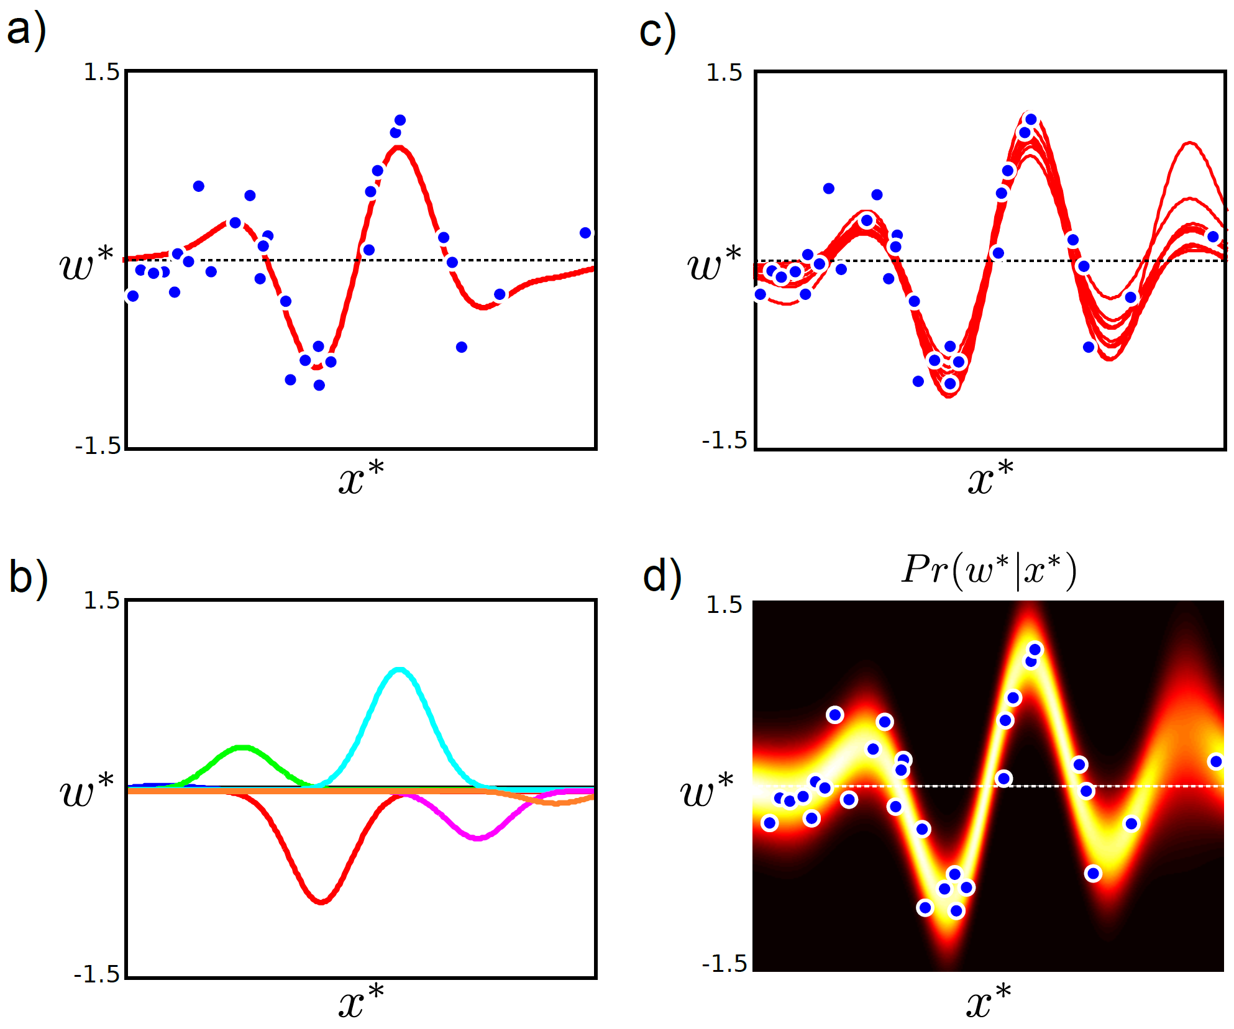
Computer vision: models, learning and inference. ©2011 Simon J.D. Prince
31

Slide 32
The Kernel Trick
Notice that the final equation doesn’t need the data itself, but just dot products between data items of the form z_{i}^{T}z_{j}
So, we take data x_{i} and x_{j} pass through non-linear function to create z_{i} and z_{j} and then take dot products of different z_{i}^{T}z_{j}
Computer vision: models, learning and inference. ©2011 Simon J.D. Prince
32

Slide 33
The Kernel Trick
So, we take data x_{i} and x_{j} pass through non-linear function to create z_{i} and z_{j} and then take dot products of different z_{i}^{T}z_{j}
Key idea:
Define a “kernel” function that does all of this together.
Takes data x_{i} and x_{j}
Returns a value for dot product z_{i}^{T}z_{j}
If we choose this function carefully, then it will correspond to some underlying z=f[x].
Never compute z explicitly - can be very high or infinite dimension
Computer vision: models, learning and inference. ©2011 Simon J.D. Prince
33

Slide 34
Gaussian Process Regression
Before
After
Computer vision: models, learning and inference. ©2011 Simon J.D. Prince
34

Slide 35
Example Kernels
(Equivalent to having an infinite number of radial basis functions at every position in space. Wow!)
Computer vision: models, learning and inference. ©2011 Simon J.D. Prince
35

Slide 36
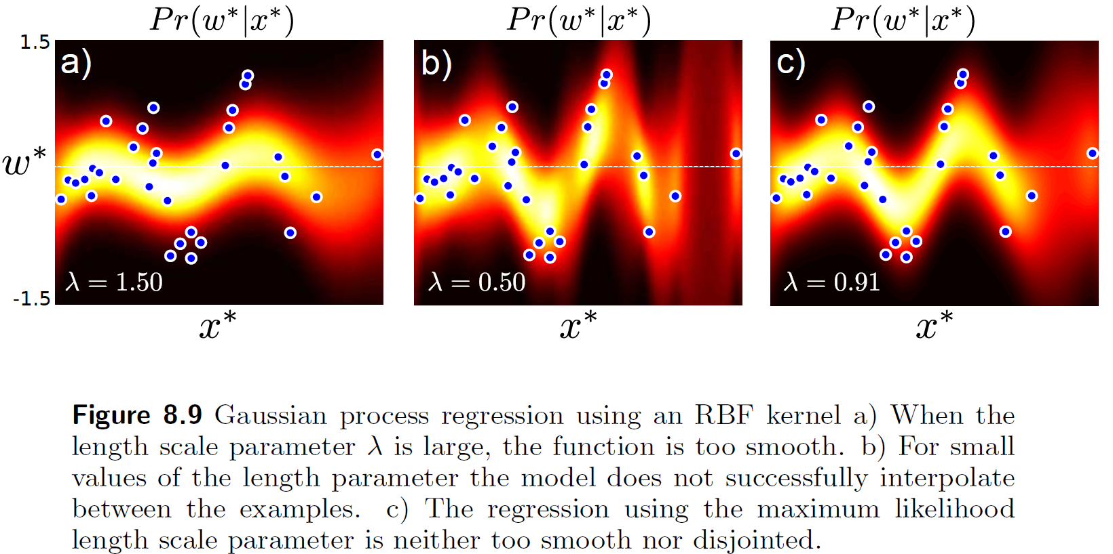
RBF Kernel Fits
Computer vision: models, learning and inference. ©2011 Simon J.D. Prince
36

Slide 37
Fitting Variance
We’ll fit the variance with maximum likelihood
Optimize the marginal likelihood (likelihood after gradients have been integrated out)
Have to use non-linear optimization
Computer vision: models, learning and inference. ©2011 Simon J.D. Prince
37

Slide 38
Structure
Linear regression
Bayesian solution
Non-linear regression
Kernelization and Gaussian processes
Sparse linear regression
Dual linear regression
Relevance vector regression
Applications
Computer vision: models, learning and inference. ©2011 Simon J.D. Prince
38

Slide 39
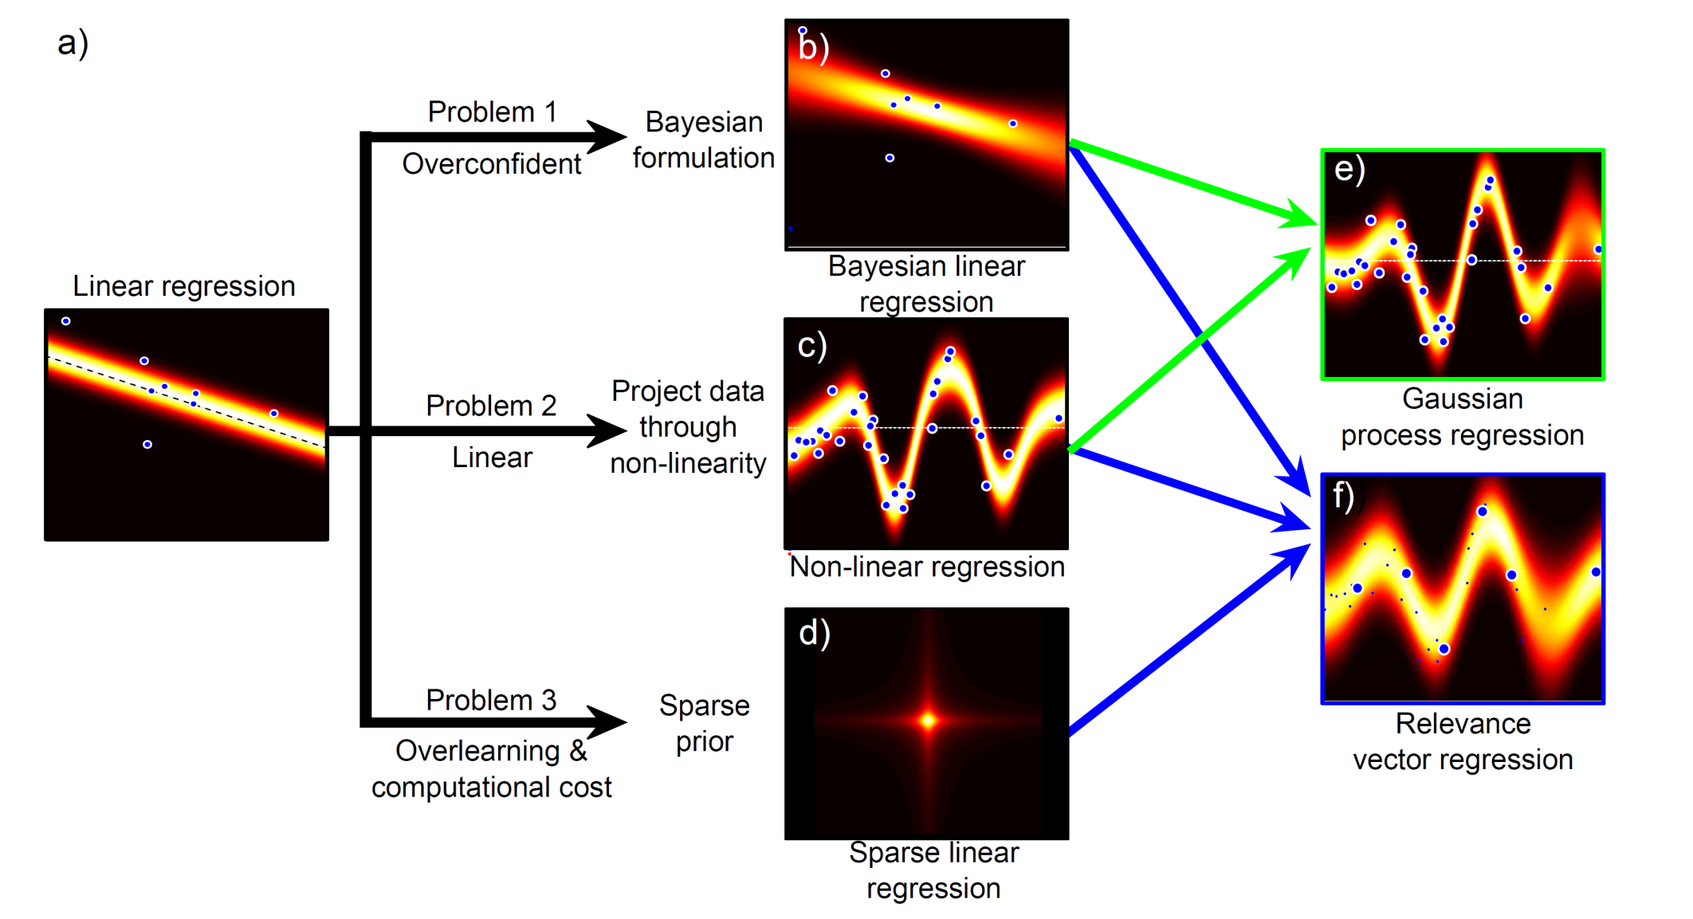
Regression Models
Computer vision: models, learning and inference. ©2011 Simon J.D. Prince
39

Slide 40
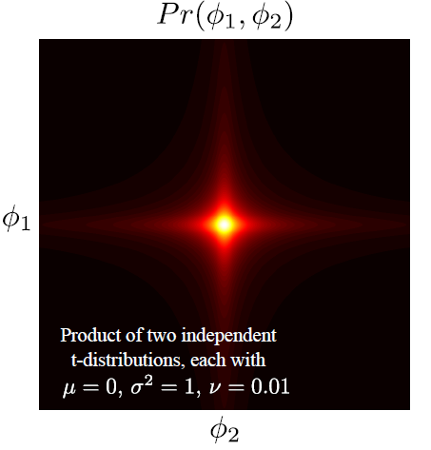
Sparse Linear Regression
Perhaps not every dimension of the data x is informative
A sparse solution forces some of the coefficients in φ to be zero
Method:
– apply a different prior on φ that
encourages sparsity
– product of t-distributions
Computer vision: models, learning and inference. ©2011 Simon J.D. Prince
40

Slide 41
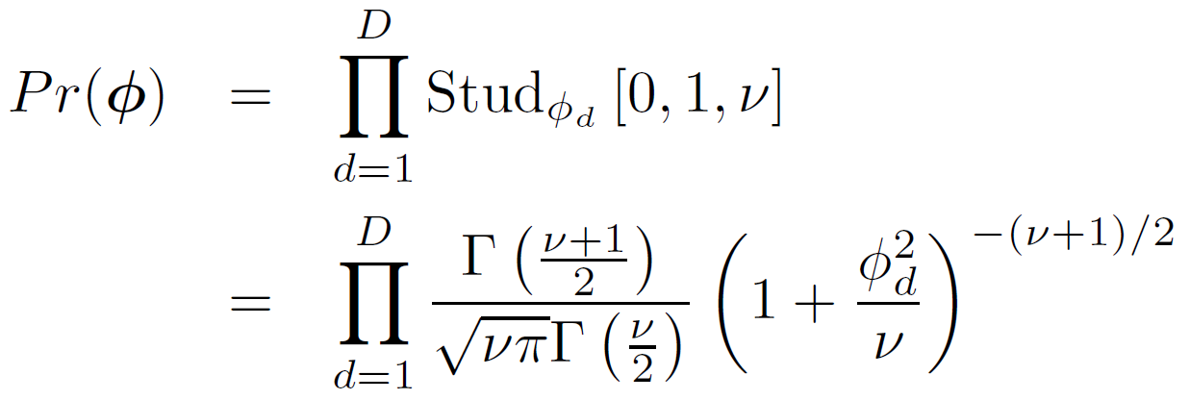
Sparse Linear Regression
Apply product of t-distributions to parameter vector
As before, we use
Now the prior is not conjugate to the normal likelihood. Cannot compute posterior in closed from
Computer vision: models, learning and inference. ©2011 Simon J.D. Prince
41

Slide 42
Sparse Linear Regression
To make progress, write as marginal of joint distribution
Diagonal matrix with hidden variables {h_{d}} on diagonal
Computer vision: models, learning and inference. ©2011 Simon J.D. Prince
42

Slide 43
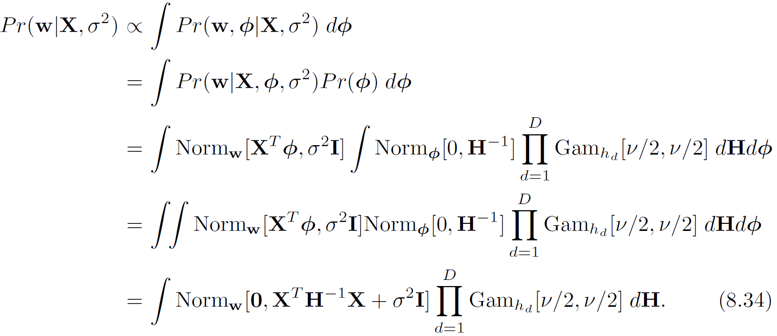
Sparse Linear Regression
Substituting in the prior
Still cannot compute, but can approximate
Computer vision: models, learning and inference. ©2011 Simon J.D. Prince
43

Slide 44
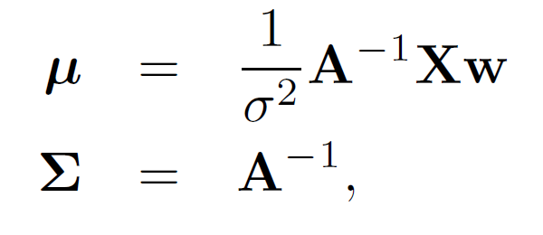
Sparse Linear Regression
To fit the model, update variance σ² and hidden variables {h_{d}}.
To choose hidden variables
To choose variance
where
Computer vision: models, learning and inference. ©2011 Simon J.D. Prince
44

Slide 45
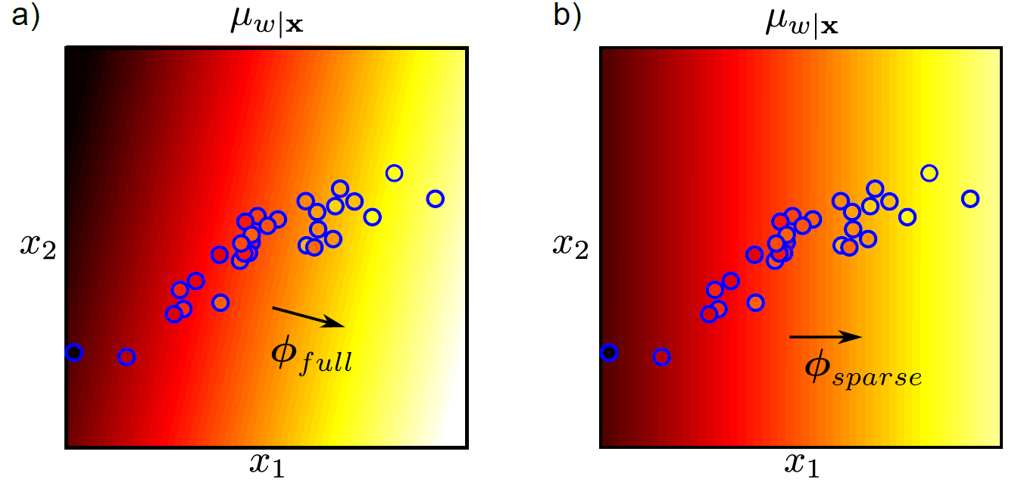
Sparse Linear Regression
After fitting, some of hidden variables become very big, implies prior tightly fitted around zero, can be eliminated from model
Computer vision: models, learning and inference. ©2011 Simon J.D. Prince
45

Slide 46
Sparse Linear Regression
Doesn’t work for non-linear case as we need one hidden variable per dimension – becomes intractable with high dimensional transformation. To solve this problem, we move to the dual model.
Computer vision: models, learning and inference. ©2011 Simon J.D. Prince
46

Slide 47
Structure
Linear regression
Bayesian solution
Non-linear regression
Kernelization and Gaussian processes
Sparse linear regression
Dual linear regression
Relevance vector regression
Applications
Computer vision: models, learning and inference. ©2011 Simon J.D. Prince
47

Slide 48
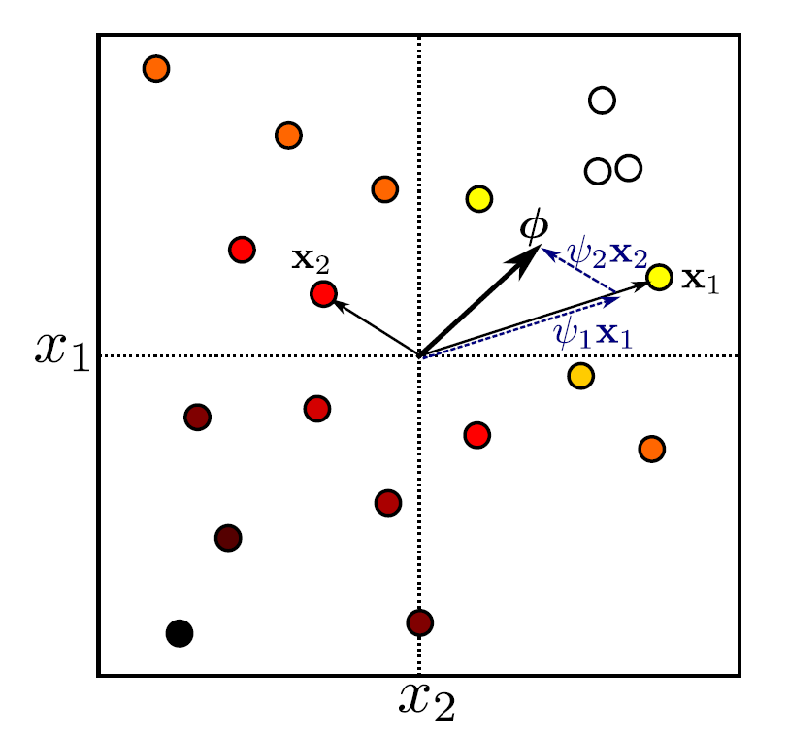
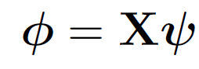
Dual Linear Regression
KEY IDEA:
Gradient Φ is just a vector in the data space
Can represent as a weighted sum of the data points
Now solve for Ψ. One parameter per training example.
Computer vision: models, learning and inference. ©2011 Simon J.D. Prince
48

Slide 49
Dual Linear Regression
Original linear regression:
Dual variables:
Dual linear regression:
Computer vision: models, learning and inference. ©2011 Simon J.D. Prince
49

Slide 50
Maximum likelihood
Maximum likelihood solution:
Dual variables:
Same result as before:
Computer vision: models, learning and inference. ©2011 Simon J.D. Prince
50

Slide 51
Bayesian case
Compute distribution over parameters:
Gives result:
where
Computer vision: models, learning and inference. ©2011 Simon J.D. Prince
51

Slide 52
Bayesian case
Predictive distribution:
where:
Notice that in both the maximum likelihood and Bayesian case depend on dot products X^{T}X. Can be kernelized!
Computer vision: models, learning and inference. ©2011 Simon J.D. Prince
52

Slide 53
Structure
Linear regression
Bayesian solution
Non-linear regression
Kernelization and Gaussian processes
Sparse linear regression
Dual linear regression
Relevance vector regression
Applications
Computer vision: models, learning and inference. ©2011 Simon J.D. Prince
53

Slide 54
Regression Models
Computer vision: models, learning and inference. ©2011 Simon J.D. Prince
54

Slide 55
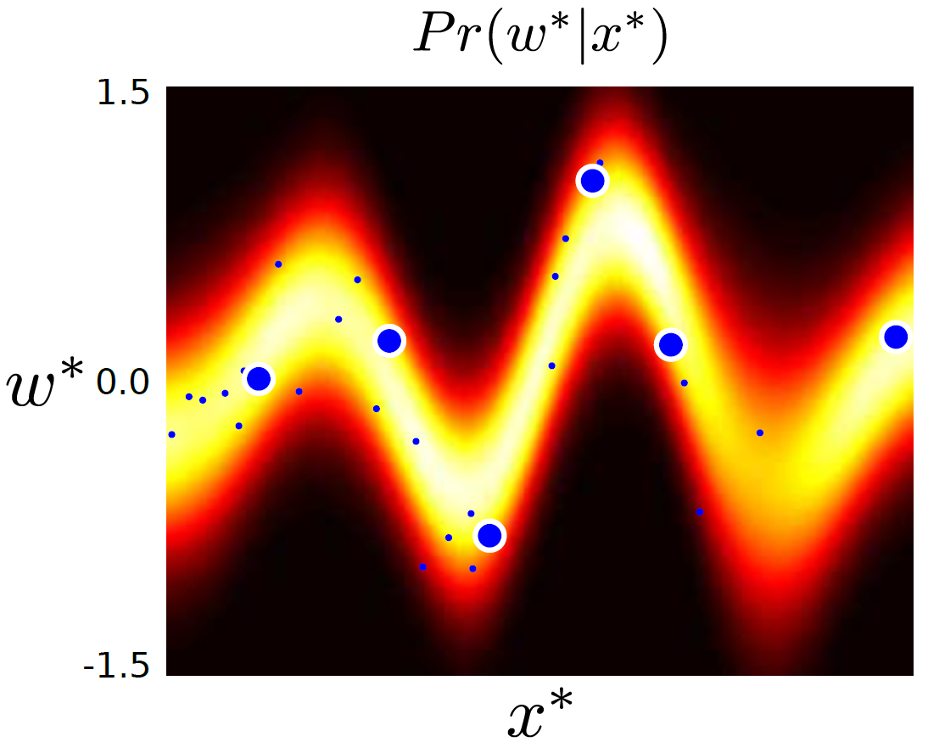
Relevance Vector Machine
Combines ideas of
Dual regression (1 parameter per training example)
Sparsity (most of the parameters are zero)
i.e., model that only depends sparsely on training data.
Computer vision: models, learning and inference. ©2011 Simon J.D. Prince
55

Slide 56
Relevance Vector Machine
Using same approximations as for sparse model we get the problem:
To solve, update variance σ² and hidden variables {h_{d}} alternately.
Notice that this only depends on dot-products and so can be kernelized
Computer vision: models, learning and inference. ©2011 Simon J.D. Prince
56

Slide 57
Structure
Linear regression
Bayesian solution
Non-linear regression
Kernelization and Gaussian processes
Sparse linear regression
Dual linear regression
Relevance vector regression
Applications
Computer vision: models, learning and inference. ©2011 Simon J.D. Prince
57

Slide 58
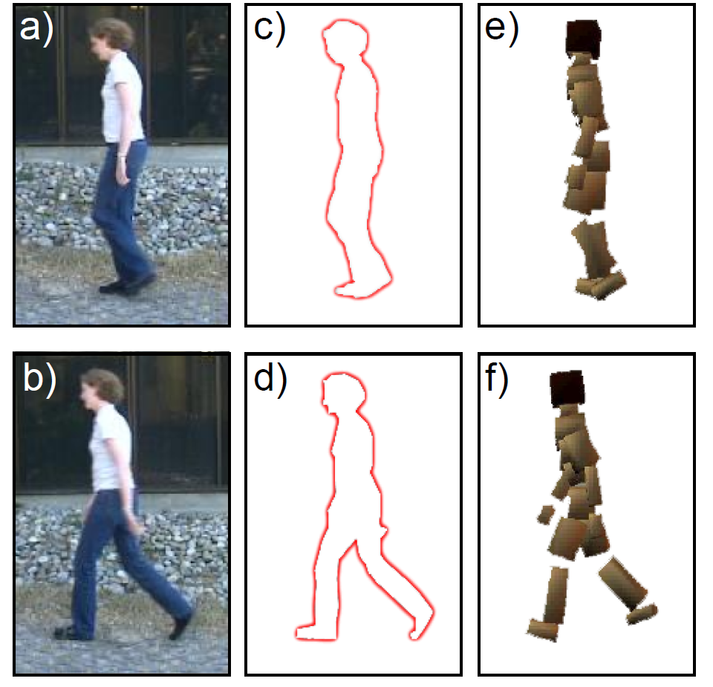
Body Pose Regression (Agarwal and Triggs 2006)
Encode silhouette as 100x1 vector, encode body pose as 55 x1 vector. Learn relationship
Computer vision: models, learning and inference. ©2011 Simon J.D. Prince
58

Slide 59
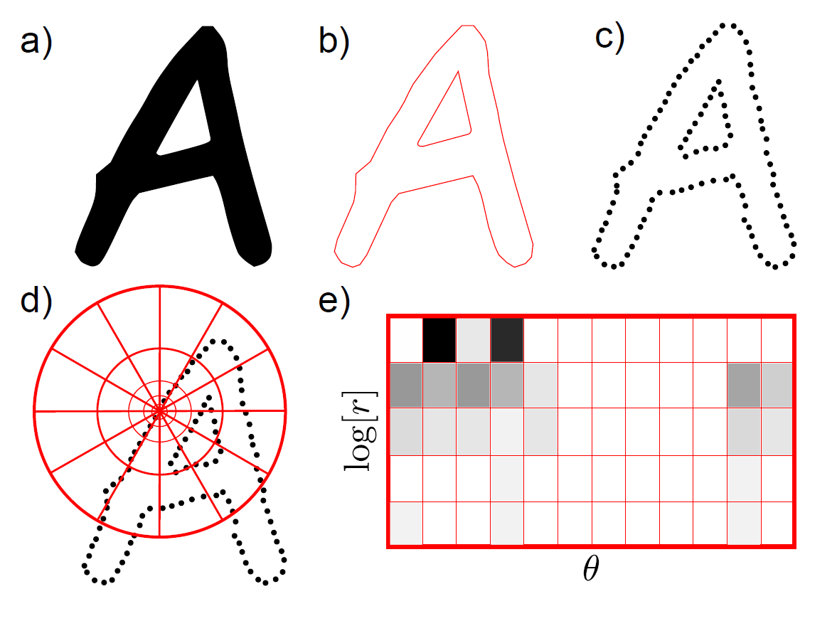
Shape Context
Returns 60 x 1 vector for each of 400 points around the silhouette
Computer vision: models, learning and inference. ©2011 Simon J.D. Prince
59

Slide 60
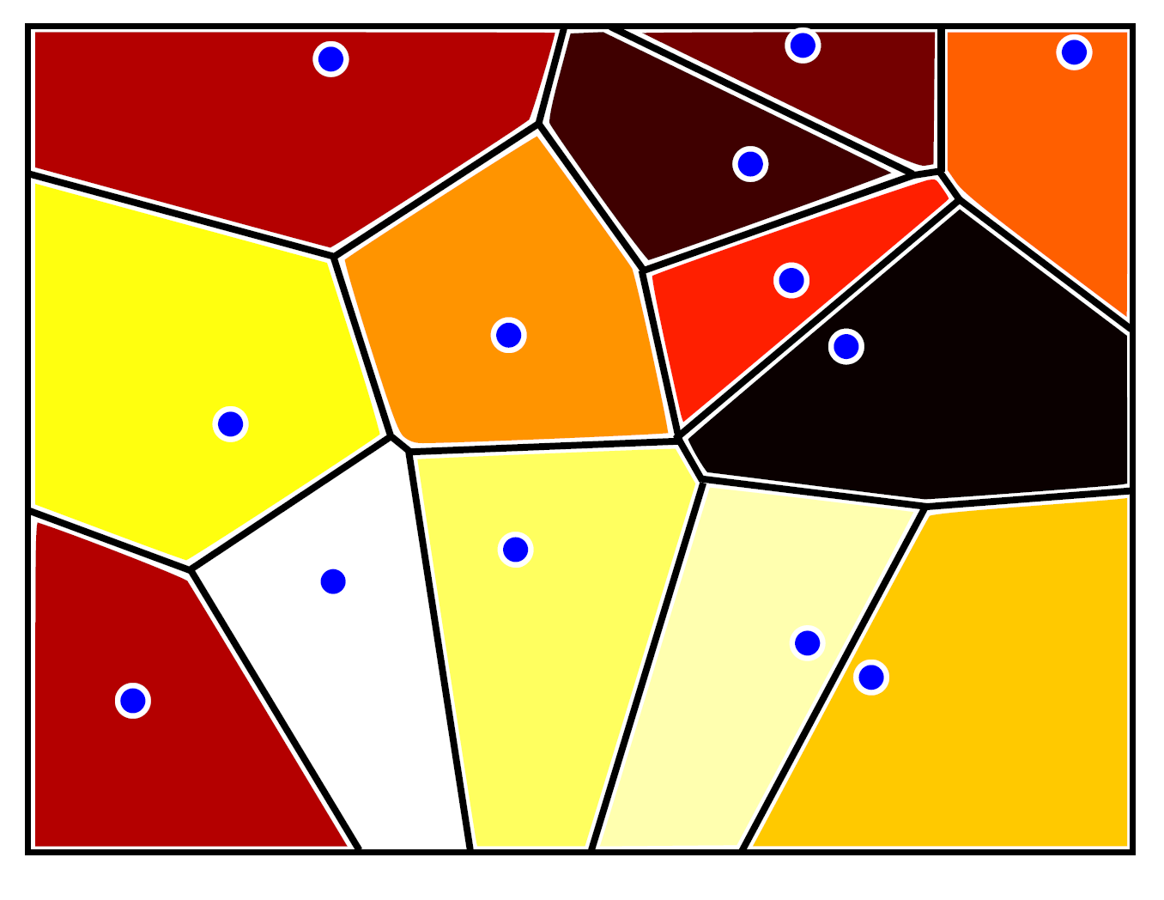
Dimensionality Reduction
Cluster 60D space (based on all training data) into 100 vectors
Assign each 60x1 vector to closest cluster (Voronoi partition)
Final data vector is 100x1 histogram over distribution of assignments
Computer vision: models, learning and inference. ©2011 Simon J.D. Prince
60

Slide 61
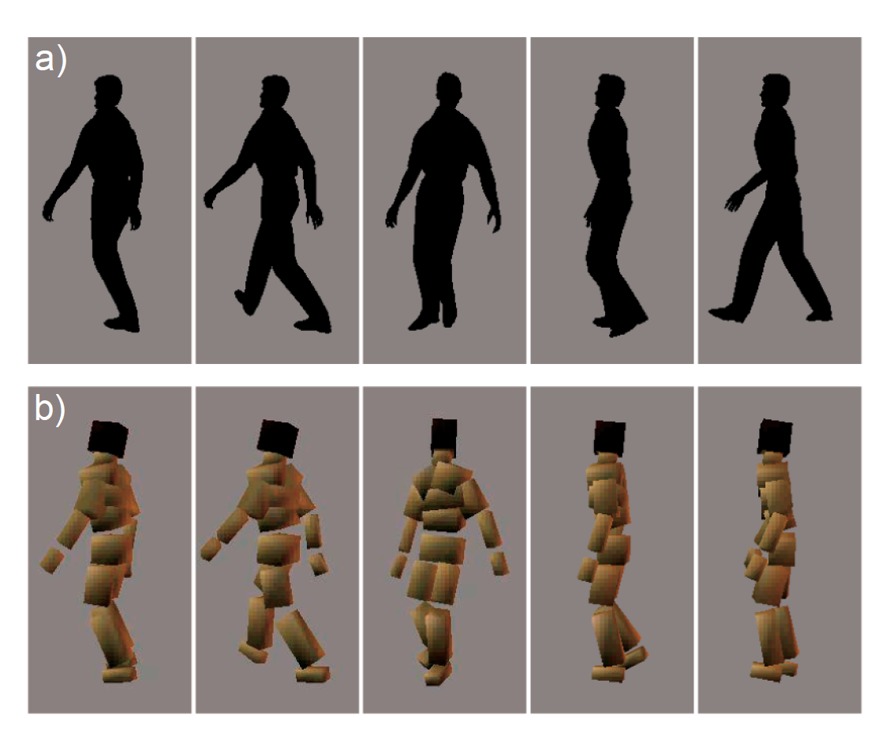
Results
2636 training examples, solution depends on only 6% of these
6 degree average error
Computer vision: models, learning and inference. ©2011 Simon J.D. Prince
61

Slide 62
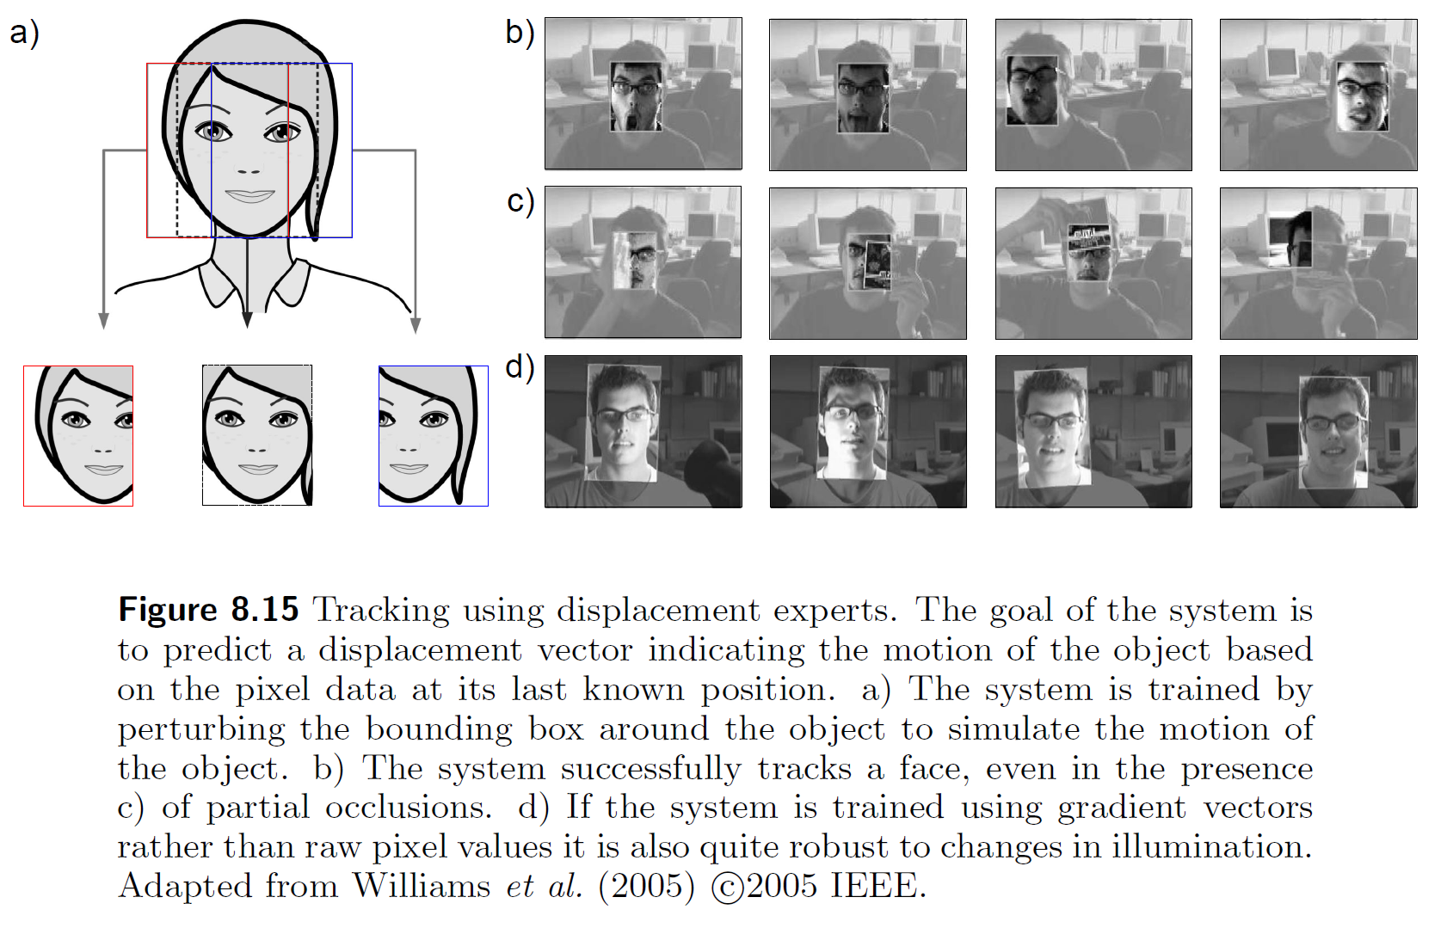
Displacement experts
Computer vision: models, learning and inference. ©2011 Simon J.D. Prince
62

Slide 63
Regression
Not actually used much in vision
But main ideas all apply to classification:
Non-linear transformations
Kernelization
Dual parameters
Sparse priors
Computer vision: models, learning and inference. ©2011 Simon J.D. Prince
63

